Slide 1
Compared to Whom?
Reference bias is driven by role models
Notes:
Hello, I am Ben, a third year PhD Student working with Angela, and I would like to present to you some of our past published work on reference bias, some unpublished results, and a proposed third study.
I would love to get your thoughts on our proposed experiment.

Slide 2

How much self-control do you have when it comes to exercise?
A little
A medium amount
A lot
0
1
2
3
4
5
6
7
8
9
10
Notes:
Take a moment to see this item and choose a response option. How did you come up with an answer?

Slide 3
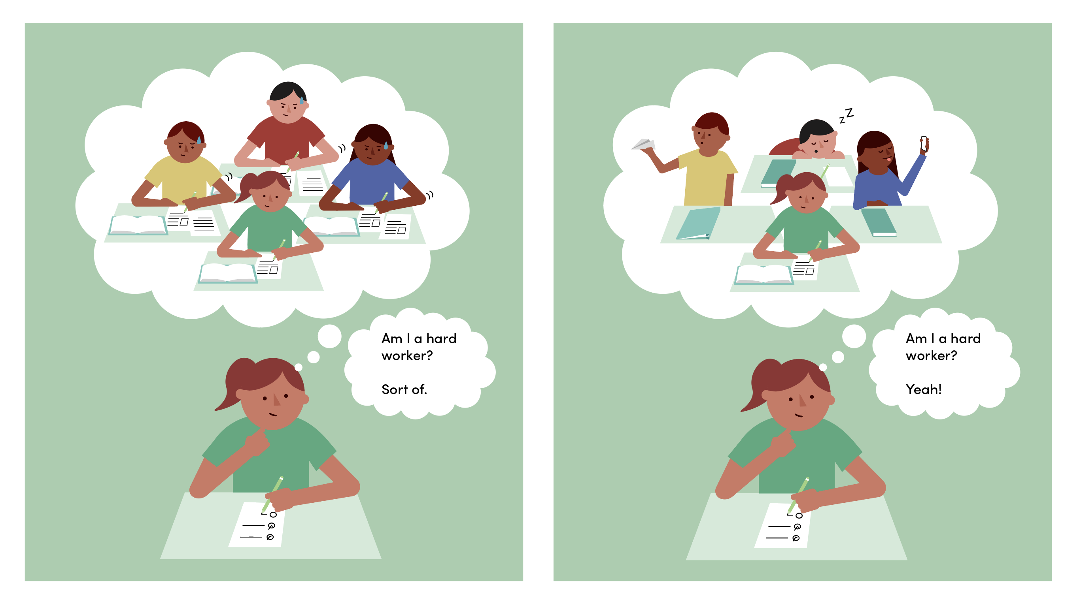
Thanks
Notes:
Imagine a student answering the very same question, just like you did. To respond to such a question, you must bring certain information to memory

Slide 4
Thanks
Notes:
One particularly interesting memory, might be of how this student compares to other students in her grade. In this case, all of her classmates are usually very hard-working, and in comparison, she might consider herself to be

Slide 5
Thanks
Notes:
Only sort of a hard worker.

Slide 6
Thanks
Notes:
Now consider the case on the right. Comparatively speaking, the student now seems like much more of a hardworker.

Slide 7
Thanks
Notes:
And even if she is equally hardworking in the left and the right, she might now say she definitely is a hard worker.

Slide 8
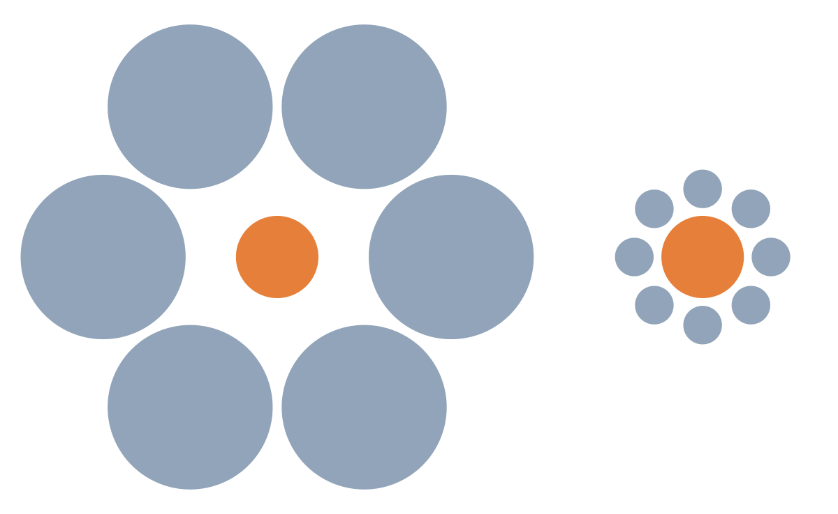
What is reference bias?
Duckworth & Yeager (2015), West et al., (2016), Lira et al., (2022)
Notes:
In the same way in which visual perception is affected by the objects in the background

Slide 9
What is reference bias?
Reference bias is systematic error that arises when participants use different implicit standards to judge their behavior when responding to the same questionnaire items
Duckworth & Yeager (2015), West et al., (2016), Lira et al., (2022)
Notes:
Our perceptions of ourselves will be affected by those around us, and the reference poins, or standards, they produce in our minds.
Reference bias is …
This means that two people with the same level of a trait may report differently if they do not share the same reference points.

Slide 10
How do we answer questionnaires?
I have a lot of self control when it comes to exercise
Comprehension
Retrieval
Judgment
Response
Editing
“What does it mean to ‘have a lot of self-control when it comes to exercise’?”
“What are times when I have behaved like this or unlike this?”
“What do these memories mean?
Putting them all together, do I have self-control for exercise?”
“I should respond with ‘Somewhat like me’”
“I don’t want to seem lazy, I better respond with
‘Very much like me’”
Duckworth & Yeager (2015), Tourangeau et al., (2000), Schwarz et al., (2001)
Notes:
Dominant models in survey methods suggest that answering an item, like we did at the start of the talk, is a five-stage process.
In the first step, we must comprehend what the words we are reading mean. What does it mean to be a HW.
Then, we must recall the relevant memories to respond to the item. A student answering a q might think back and remember times when she behaved like a hard worker, and times when she did not.
Then, all of these memories must be integrated into a summary judgment. Putting them all together, would I consider myself a hardworker.
Then this judgement needs to be mapped into one of the reponse options. A student might consider translating their summary judgment inot the repsose somewhat like me
Finally, if there are incentives to do so, respondents might edit their responses to self-present. In our example, the student might change her response from somewhat like me to very much like me to avoid seeming lazy,

Slide 11
How do we answer questionnaires?
I am a hard worker.
Comprehension
Retrieval
Judgment
Response
Editing
Compared to whom?
Against what reference point?
Morina (2021), Mussweiler et al., (2003), Kahnemann (1992)
Notes:
While we know a lot about biases in the editing and the response stage, like faking and acquiescence, we know less about the other stages. While reference bias permeates the questionnaire response process, I suggest that it mainly enters at the judgment stage.
We know from the Judgment and Decision-Making literature that all judgment is comparative, and that anchors can substantively change our decisions. In that vein, when we integrate all the trait relevant memories into a summary judgment, we must make that judgement in comparison to a reference point, or a standard.

Slide 12
If a person has a lot of self-control when it comes to exercise, how many minutes per day would you guess they work out?
0
10
20
30
40
50
60
70
80
90
100
Average minutes per day
Notes:
So, here's an item that attempts to get at what your standards are. It is very likely that even here in DSM, different people have different standards for what "a lot of self control for exercise" means.

Slide 13
Standards
Self-Reported
Self Control
Own Behavior
Bandura (1971); Cialdini (2007); Sacerdote (2011)
Notes:
So how do we answer a questionnaire item?
First, our own behavior probably carries some weight. After all, when figuring out if you are self-contorlled, you have to recall situations in which you worked out despite being tired.
However, reference bias would suggest that this is not all that matters. Different standards may lead to different responses, even for two people with the same behavior. If I have higher standards, I am likely to rate myslef lower.
Finally, our standards might also influence our behavior directly. If I have higher standards for exercise, I am more likely to engage in those behaviors.

Slide 14

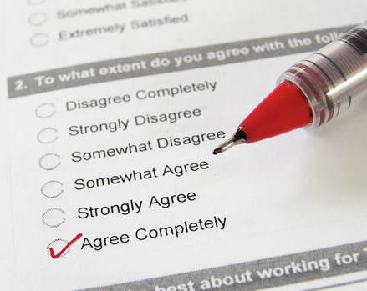
KIPP charter schools increase test scores and college enrollment but not self-reported self-control
West et al., (2016); Dobbie & Fryer (2015); Tuttle et al., (2013,2015)
Notes:
Early evidence for reference bias came from experimental evaluations of charter schools. schools are oversubscribed and select students by lottery, which means that comparing students admitted to those who participated in the lottery and were not selected and went on to public school provides a test of the causal effects of charter schools. Results from these evaluations suggest that charter schools
increase objective outcomes such as test scores and college enrollment, despite
not increasing self-reported self control. There are two potential explanations. Either charter schools change behavior without changing underlying personality, or reference bias obscures the effect because charter schools also raise the reference points students use to judge themselves.

Slide 15
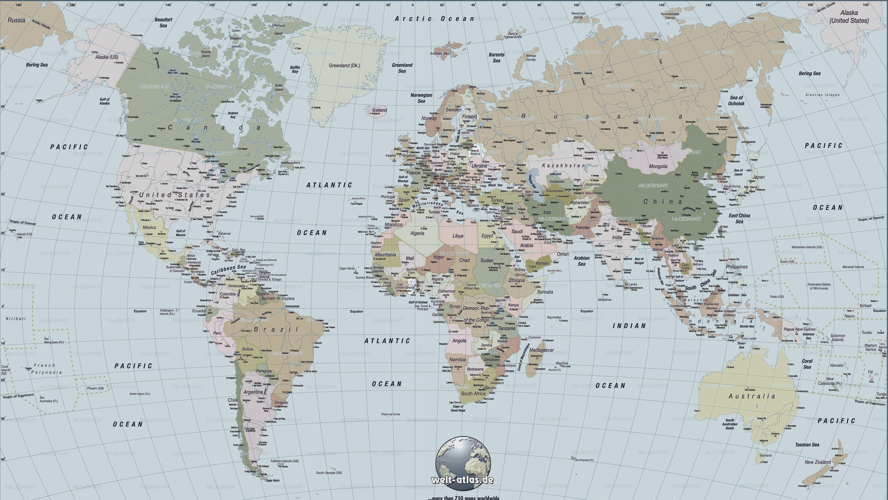
The average Japanese citizen rates themselves as less conscientious than the average American citizen
Mõttus et al., (2012); Schmitt et al., (2007)
Notes:
Similar evidence from cross cultural personality research also provides paradoxical results. In survey studies of over 50 countries, Japanese citizens consistently rate themselves as less conscientious than American citizens. Does this represent true country-level differences in personality, or a measurement artifact?

Slide 16
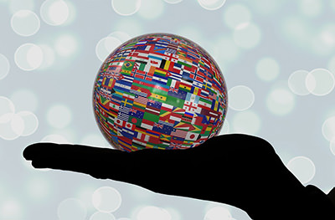

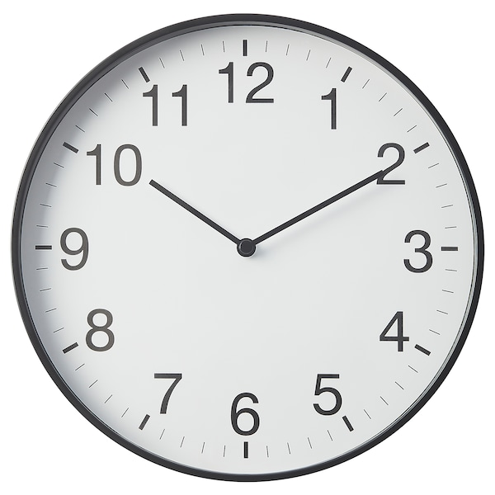
Even though cultural experts and objective markers of conscientiousness negatively relate to self-reports
Peng et al., (1997); Heine et al., (2008); Heine et al., (2002)
Notes:
Research suggests the latter. In one study, the more cultural experts rated a country as having a particular trait, the less the country’s citizens endorsed that trait. In another study, objective markers for conscientiousness at the country level, such as the efficiency of post offices and the accuracy of clocks, negatively correlated to country level self reported conscientiousness. This mismatch between self-reports and other validity criteria points to reference bias.

Slide 17
This evidence might not be conclusive because…
The cultural experts might be biased
Proxies might be not valid
Peng et al., (1997); Heine et al., (2008); Heine et al., (2002)
Notes:
However, this evidence might not be conclusice.
In the first case, the cultural experts might be biased.
In the second, the behavioral proxies used might not be valid.
To rule our whether these are measurement effects or not, it may be useful to understand the cognitive processes of questionnaire responding.

Slide 18
Notes:
Let me briefly show you how we operationalized reference bias to overcome the limitations of prior data

Slide 19
To estimate reference bias, we do something unusual
Self-Reported
Self Control
Behavior
Notes:
Usually, we use self-reports to predict some outcome. For example, we might look at how self-reports of self-control show that more self contorlled students receive higher grades.

Slide 20
To estimate reference bias, we do something unusual
Behavior
Self-Reported
Self Control
Notes:
However, for reference bias, we are interested in how people respond to quetionnaires. So rather than using self reports as a predictor, we will try to understand how people rate themselves.
And as we saw before, how we behave can inform our repsonse process.

Slide 21
To estimate reference bias, we do something unusual
Behavior
Self-Reported
Self Control
Peers’ Behavior
Notes:
Once we control for our own behavior, we are comparing comparable individuals.
Therefore, absent reference bias, how people surrounding us behave, should have no influence on how we rate ourselves.

Slide 22
Evidence for reference bias within schools in a natural experiment in Mexico
Lira et al., (2022)

Slide 23
Evidence for reference bias within schools
Conscientiousness
Standards
Lira et al., (2022)
Notes:
So here's some data from almost 22K students in 62 schools.
We find that as expected, students with higher GPAs tend to rate themselves higher in self control. Note that now we are controlling for a student's GPA, so the following coefficients are the effect of classmates' GPA for two students who behave similarly.
Consistent with reference bias, students reported lower conciencitusness when Near peers (that is students who shared classes with the target individual) had higher grades.
Far peers—students in the same school, but not the same classes—had no bearing on how a student rates their conscientiousness.
For standards, students with higher grades tended to have higher standards, and these standards were informed by their classmates.

Slide 24
Task measures of self-regulation are not contaminated by reference bias
Lira et al., (2022)

Slide 25
Where do standards come from?
Notes:
Now, let me transition into our unpublished data, which primarily deals with the question of where do standards come from.

Slide 26
Think of a close friend with whom you spend a lot of time. How many minutes per day would you guess they work out?
0
10
20
30
40
50
60
70
80
90
100
Average minutes per day
Notes:
Read

Slide 27
Think of someone you know who has a lot of self-control when it comes to exercise. How many minutes per day would you guess they work out?
0
10
20
30
40
50
60
70
80
90
100
Average minutes per day
Notes:
Read.
Who you think will matter more? Close friends or role models?

Slide 28
Friend Behavior
Standards
Self-Reported
Self Control
Role Model Behavior
Own Behavior
Bandura (1971); Cialdini (2007); Sacerdote (2011)
Notes:
Coming back to our guiding model,
We see how friends might influence our behavior and standards.
And role models might also influence our behavior and standards.

Slide 29
How many minutes per day do you work out?
0
10
20
30
40
50
60
70
80
90
100
Average minutes per day
Notes:
Take a moment to see this item and choose a response option. How did you come up with an answer?

Slide 30
Study 1
Initial evidence for role models in a study of 1100 adolescents over 2 years
Notes:
Study one provides initial evidence for role models in a study of 1100 adolescents over 2 years.

Slide 31
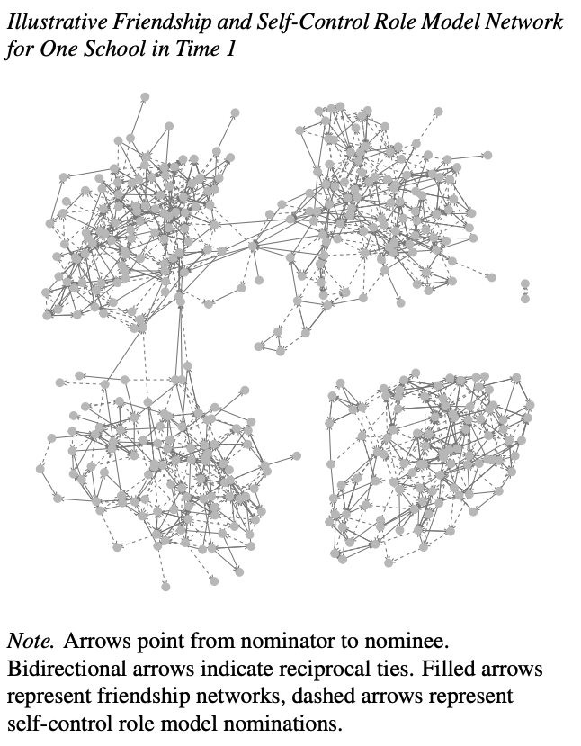
Networks of friendship and role models are distinct
20% of cross nomination
Low (and decreasing) correlation of both networks.
High reciprocity in friend networks, low reciprocity in role model networks
Low correlation of centrality measures across networks.

Slide 32
Exemplars have higher GPA than the ego

Slide 33
Evidence that role models—not friends–account for reference bias
Notes:
As before, students with higher GPAs tended to rate themselves higher in self-control.
However, while the GPAs of their close friends had no bearing on their self ratings, they rated themselves 15% of a SD lower for each SD increase in role model GPA.
However, this study was not pre-registered since we used pre-existing data.
We also don't know how well these results generalize to other domains, and whether this effect is unique to adolescence.

Slide 34
But the opposite is true for student grades

Slide 35
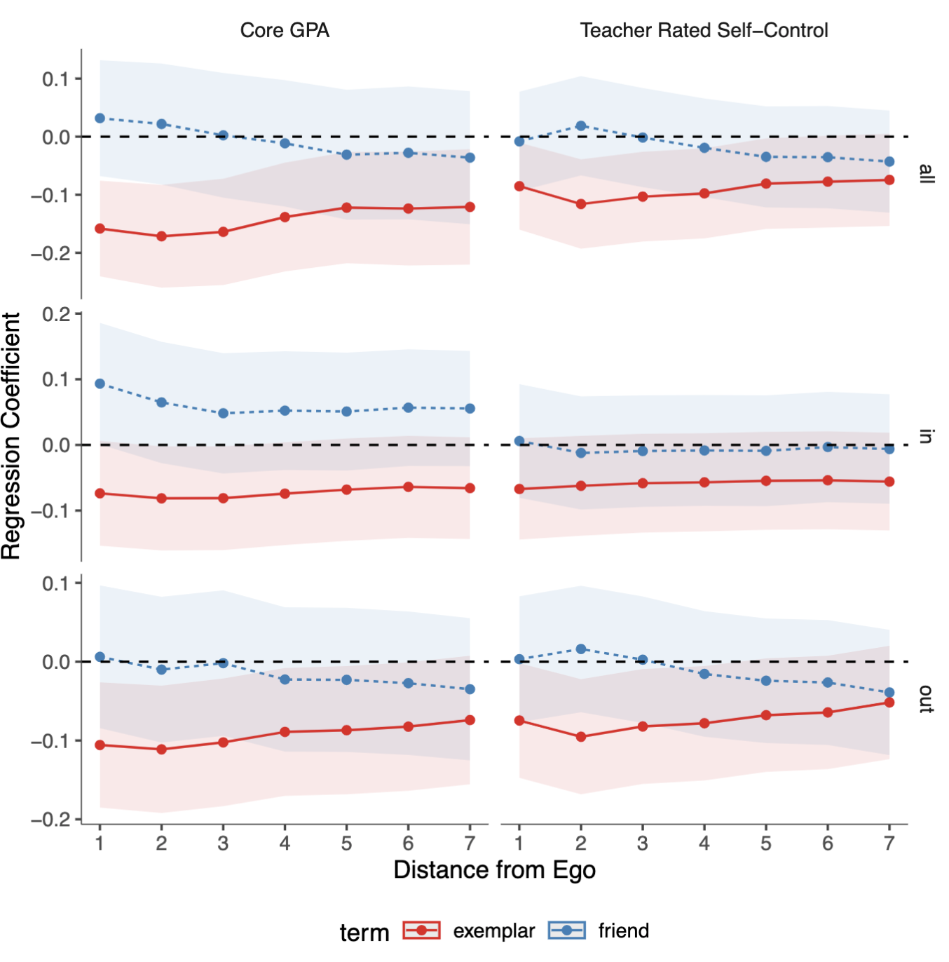
And the effect is driven by close outgoing ties

Slide 36
Discussion
Friends’ and role models’ objectively measured behavior differentially relates to behavior and self-ratings of self control
Limitations
Do the findings generalize to other domains?
Do the findings generalize to other age groups?
What is the mechanism?

Slide 37

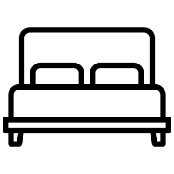

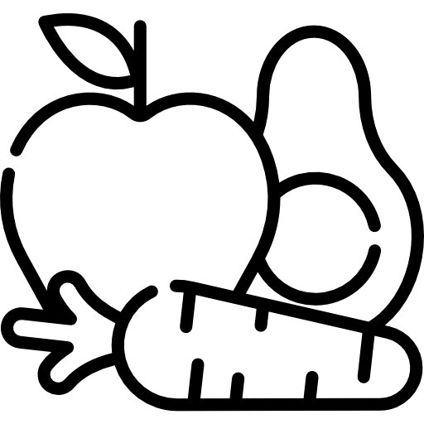

Study 2
Pre-registered replication and extension in a sample of 5,626 adults in six domains
Notes:
Study 2, was a pre-registered replication and extension in a sample of almost 6k adults in six domains: Exercise, saving, bedtime procrastination, puntuality, healthy eating, and social media distraction.

Slide 38
Method
5,432 Prolific participants assigned to one of six domains
Exercise, Saving, Healthy eating
Punctuality, Social media distraction, Bedtime procrastination
Nominated 2 friends and role models
Self reported their behavior, standards, and self-ratings of self-control
Estimated their friend’s and role model’s behavior.
We estimated how friends’ and role models’ behavior related to a person’s behavior, standards, and self-ratings of self-control

Slide 39
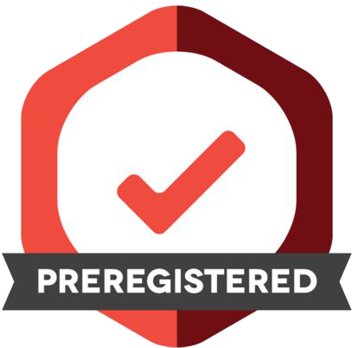
Role models matter twice as much than friends for standards
Friend Behavior
Standards
.21
-.25
.44
Self-Reported
Self Control
.24
.28
Role Model Behavior
Own Behavior
.66
.16
Notes:
I will explain our results using exercise as an example, but the results collapse across the six domains.
As expected, people who exercise more were more likely to report higher self control for exercise.
people with higher Standards for exercise, however, tended to rate themselves lower in self-control for exercise, while at the same time, exercising more.
A 1 SD increase in how much the peer role model you identified exercises is related to a 44% increase in standards, whereas friends had about half of that impact.
However, your behavior is more similar to your friends' behavior than to the behavior of your peer role models

Slide 40
Friend Behavior
.21
Standards
Friend Behavior
.21
Standards
-.41
-.25
.44
Self-Reported
Self Control
.44
Self-Reported
Self Control
.40
.24
.28
.28
Role Model Behavior
Own Behavior
Role Model Behavior
Own Behavior
.16
.68
.16
.66
Friend Behavior
.21
Standards
Friend Behavior
.21
Standards
-.25
-.25
.44
Self-Reported
Self Control
.44
Self-Reported
Self Control
.24
.24
.28
.28
Role Model Behavior
Own Behavior
Role Model Behavior
Own Behavior
.16
.66
.16
.66
Friend Behavior
.21
Standards
Friend Behavior
.21
Standards
-.25
-.25
.44
Self-Reported
Self Control
.44
Self-Reported
Self Control
.24
.24
.28
.28
Role Model Behavior
Own Behavior
Role Model Behavior
Own Behavior
.16
.66
.16
.66

Slide 41
Domain Specific Results
y | x | exercise |  | bedtime |  | healthy eating |  | saving |  | punctuality |  | social media
 |  | beta | p | beta | p | beta | p | beta | p | beta | p | beta | p
Self-Control | Standards | −0.23 | 0.00 | −0.16 | 0.00 | −0.28 | 0.00 | −0.30 | 0.00 | −0.42 | 0.00 | −0.19 | 0.00
Self-Control | Own Behavior | 0.67 | 0.00 | 0.62 | 0.00 | 0.65 | 0.00 | 0.77 | 0.00 | 0.67 | 0.00 | 0.58 | 0.00
Own Behavior | Standards | 0.18 | 0.00 | 0.09 | 0.01 | 0.20 | 0.00 | 0.30 | 0.00 | 0.40 | 0.00 | 0.22 | 0.00
Own Behavior | Friend Behavior | 0.25 | 0.00 | 0.31 | 0.00 | 0.29 | 0.00 | 0.20 | 0.00 | 0.19 | 0.00 | 0.36 | 0.00
Own Behavior | Role Model Behavior | 0.17 | 0.00 | 0.09 | 0.01 | 0.20 | 0.00 | 0.13 | 0.00 | 0.20 | 0.00 | 0.16 | 0.00
Standards | Friend Behavior | 0.14 | 0.00 | 0.11 | 0.00 | 0.21 | 0.00 | 0.25 | 0.00 | 0.26 | 0.00 | 0.22 | 0.00
Standards | Role Model Behavior | 0.38 | 0.00 | 0.36 | 0.00 | 0.56 | 0.00 | 0.50 | 0.00 | 0.41 | 0.00 | 0.39 | 0.00
Friend Behavior | Role Model Behavior | 0.23 | 0.00 | 0.10 | 0.00 | 0.45 | 0.00 | 0.35 | 0.00 | 0.40 | 0.00 | 0.29 | 0.00

Slide 42
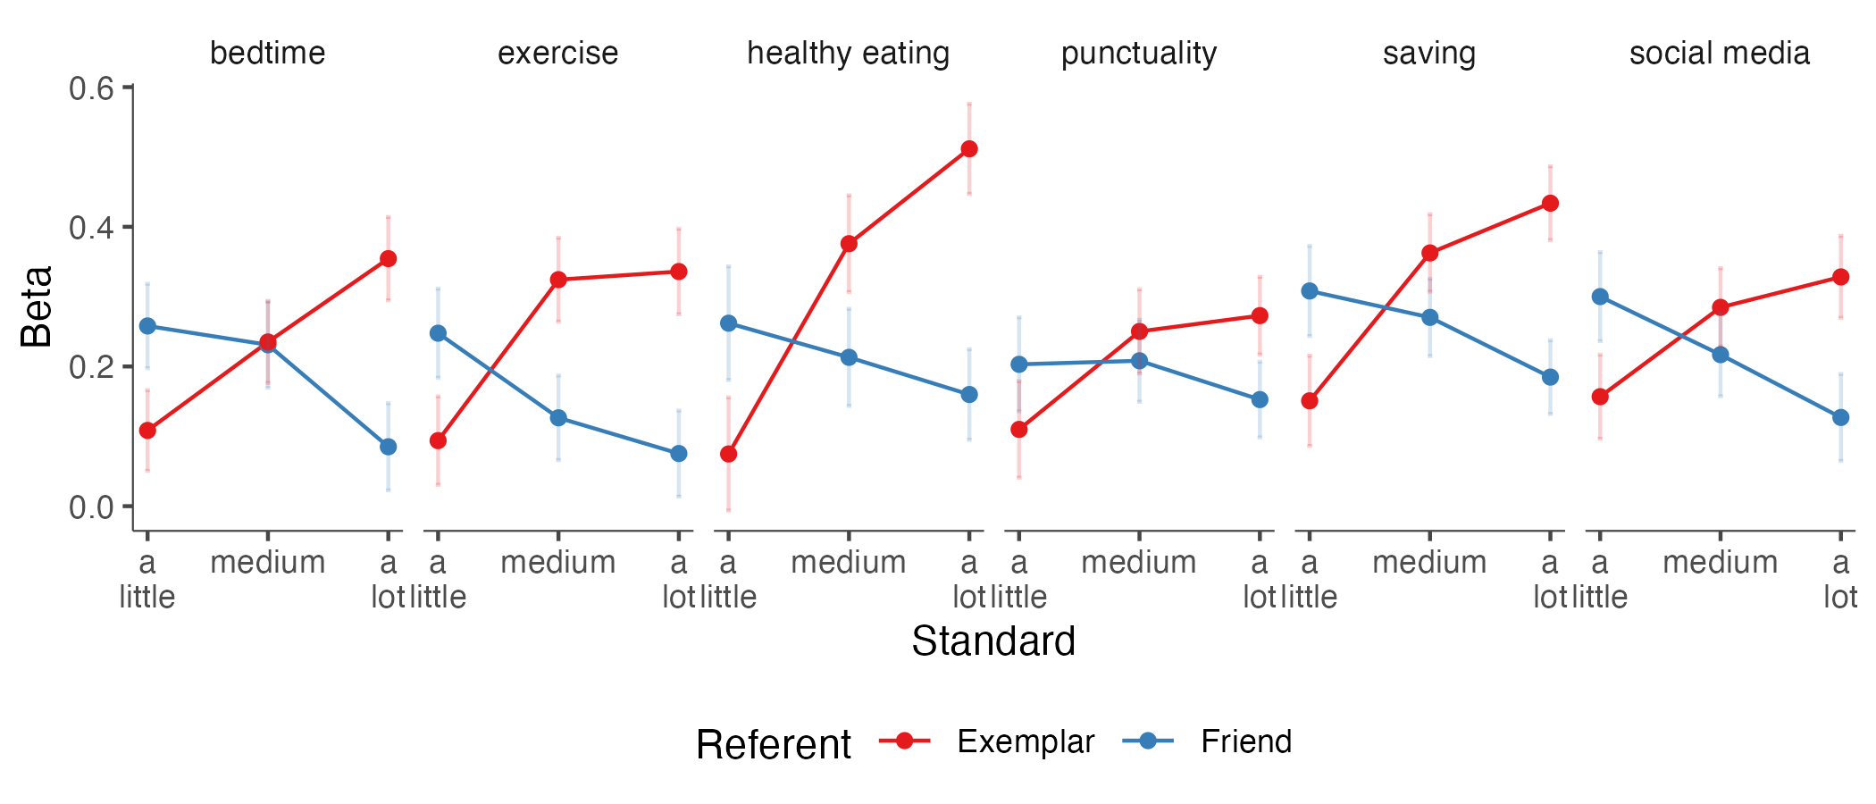
Role models set the high standards, and friends the low standards

Slide 43
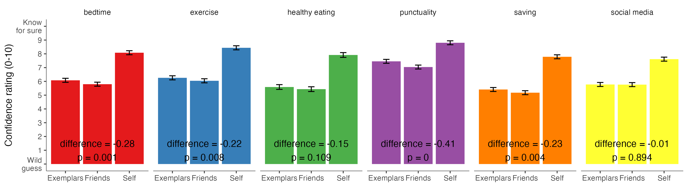
Results are not explainable by differences in ease of judgement

Slide 44
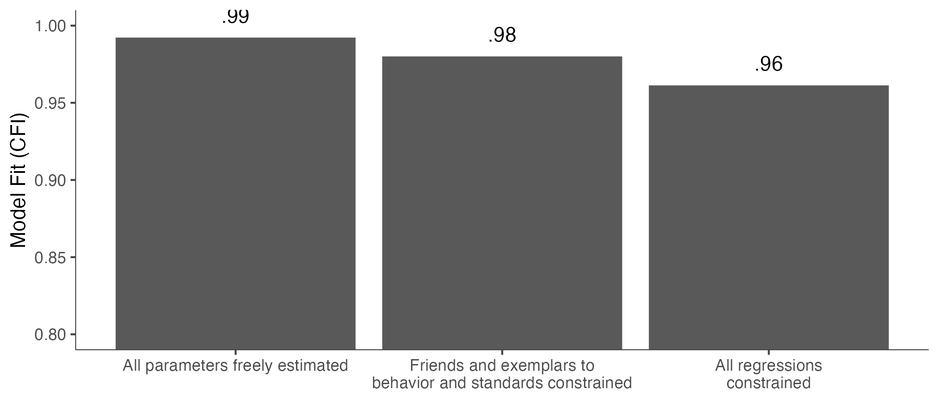
Results are moderated by the domain

Slide 45
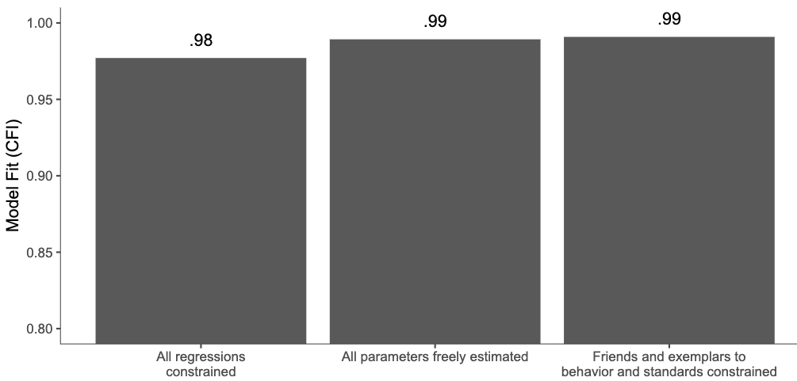
Results are not moderated by domain importance

Slide 46
Discussion
We show that results generalize other domains and ages
Is the effect causal?
Without manipulation of variables, we cannot know!
But we cannot manipulate people’s friends and role models.

Slide 47
Proposed Study 3
Experimental evidence for role models
Notes:
Finally, because both S1 and S2 are observational studies, let me present to you a proposed situation experiment to identify causal evidence for role models.

Slide 48
How many minutes per day do you work out?
0
10
20
30
40
50
60
70
80
90
100
Average minutes per day
Notes:
It would start, as before, by asking a participant how many minutes they exercise on average.
(We would do this for six as begore).

Slide 49
How many minutes per day do you work out?
20
Average minutes per day
Notes:
Imagine our participant chose 20 minutes per day, on average

Slide 50
Imagine two hypothetical people: John, a friend, and Stacy, someone else you know
Friend: John
Other person: Stacy
Notes:
Now we ask our participant to imagine to hypothetical people. John, a friend, and stacy, who is someone else.

Slide 51


Imagine you just learned that
Friend: John
Exercises
Other person: Stacy
Exercises
10
30
Average minutes per day
Average minutes per day
Notes:
Imagine that John exercises 10 minutes per day, while stacy does 30 miuntes per day.

Slide 52
Imagine you just met two people
John
Exercises
Stacy
Exercises
10
30
Average minutes per day
Average minutes per day
Notes:
Take a moment to see this item and choose a response option. How did you come up with an answer?

Slide 53
Imagine that a year goes by. John becomes a close friend. You see Stacy a couple of times and she seems very self-controlled for exercise
John
Exercises
Stacy
Exercises
10
30
Average minutes per day
Average minutes per day
Notes:
Take a moment to see this item and choose a response option. How did you come up with an answer?

Slide 54
Four conditions
 | Friend -1 SD | Friend +1 SD
Other person -1 SD
Other person +1 SD
Notes:
We can manipulate the amount of time that friends and role models exercise. From our previous data, we can choose an amount of time that is 1 SD above or below what the particicpant seleted.

Slide 55
With that in mind…
Notes:
Now we ask the participatn to keep that information in mind

Slide 56
If a person has a lot of self-control when it comes to exercise, how many minutes per day would you guess they work out?
0
10
20
30
40
50
60
70
80
90
100
Average minutes per day
Notes:
to report their standards

Slide 57
How much self-control do you have when it comes to exercise?
A little
A medium amount
A lot
0
1
2
3
4
5
6
7
8
9
10
Notes:
And self-report their self control.

Slide 58
The setup
People are assigned to one of the six domains from before
They self report their behavior
They are asked to imagine that they learn their friends exercise ±1SD, and their role models exercise ±1SD
With that in mind, they now rate their own self-control and their standards for what counts.
We ask people how much the imagined scenario represents their real life

Slide 59
Important decisions
Should we ask people to report their own level of self-control at pre-test?
We get more power, but there might be demand effects, or a desire to be consistent with the previous answer.
What is better, a guess in the present, or imagine a year into the future?

Slide 60
Role models matter more than friends for reference bias
Notes:
In closing, role models matter more tahn friends for reference boas.

Slide 61
Thanks

Slide 62




Thank you!
And thanks to
Angela L. Duckworth
David S Yeager, Joseph O’Brien (UT Austin)
Pablo Peña (U Chicago)
Tim Kautz, Amy Defnet, Kate Munkacsy (Mathematica)
Brian Galla (U Pitt)
Sidney D’Mello (UC Boulder)
Peter Meindl (West Point)

